Slide 1
Computação Gráfica
Aleatoriedade e Ruídos

Slide 2
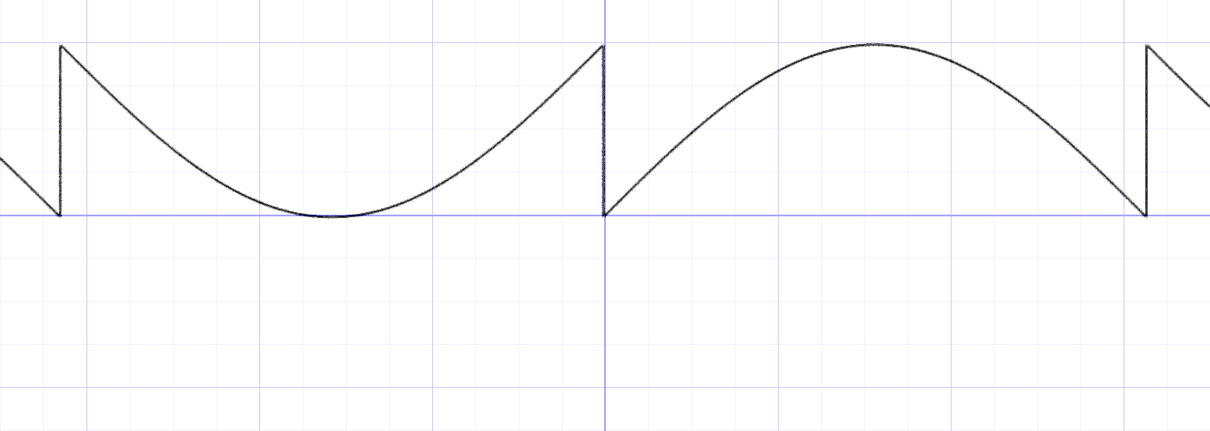
Aleatoriedade
Computadores convencionais não geram números realmente aleatórios, porém podemos criar situações que simulam isso.
y = fract(sin(x)*1.0);
Referência: The Book of Shaders https://thebookofshaders.com/10/

Slide 3
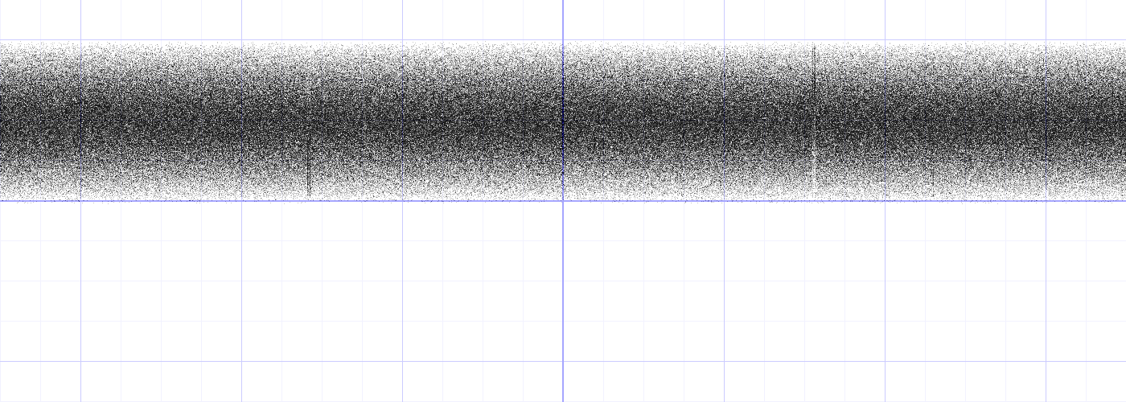
Aleatoriedade
Porém se repetirmos muito o padrão. O que você acha que acontecerá com a imagem?
y = fract(sin(x)*100000.0);
Referência: The Book of Shaders https://thebookofshaders.com/10/

Slide 4
Aleatoriedade
Brincando um pouco com o padrão conseguimos gerar algo como:
float rand(vec2 st) {
float val = dot(st.xy,vec2(12.9898,78.233));
return fract(sin(val)*43758.5453123);
}
void mainImage(out vec4 fragColor, in vec2 fragCoord){
vec2 st = fragCoord.xy/iResolution.xy;
float rnd = random(st);
fragColor = vec4(vec3(rnd),1.0);
}
Referência: The Book of Shaders https://thebookofshaders.com/10/
Notes:
Código original:
// Author @patriciogv - 2015
// http://patriciogonzalezvivo.com
#ifdef GL_ES
precision mediump float;
#endif
uniform vec2 u_resolution;
float random(vec2 st) {
float val = dot(st.xy,vec2(12.9898,78.233));
return fract(sin(val)*43758.5453123);
}
void main() {
vec2 st = gl_FragCoord.xy/u_resolution.xy;
float rnd = random(st);
gl_FragColor = vec4(vec3(rnd),1.0);
}

Slide 5
Ruídos
salt pepper noise
coherent noise
gaussian noise
Poisson noise ou shot noise
Quais as características desses ruídos?
Fonte: https://commons.wikimedia.org/wiki/User:Alejo2083/Pictures_engineering

Slide 6
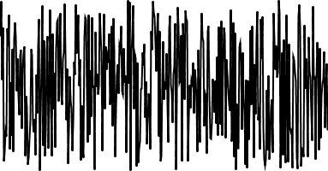
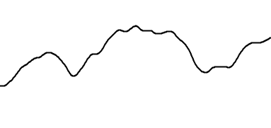
Ruídos em 1D
Totalmente aleatório:
suavemente aleatório:
fonte: https://pt.khanacademy.org/computing/computer-programming/programming-natural-simulations/programming-noise/a/perlin-noise

Slide 7
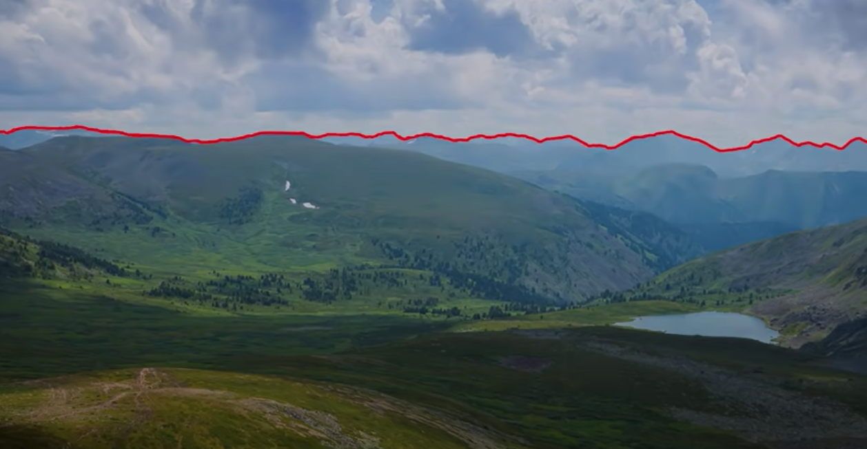
Terrenos
Por exemplo no horizonte dessa imagem, vemos que as alturas da montanha não mudam de forma totalmente aleatória.
fonte: https://www.youtube.com/watch?v=H6FhG9VKhJg

Slide 8
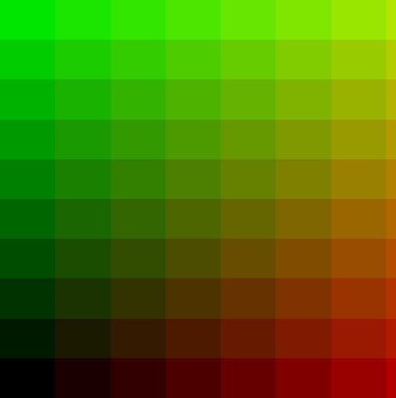
Pergunta
Como ficará a tela nesse caso?
float rand(vec2 st) {
float val = dot(st.xy,vec2(12.9898,78.233));
return fract(sin(val)*43758.5453123);
}
void mainImage(out vec4 fragColor, in vec2 fragCoord){
vec2 st = fragCoord.xy/iResolution.xy;
st *= 10.0;
vec2 ipos = floor(st);
fragColor = vec4(ipos/10.0, 0.0 ,1.0);
}
Referência: The Book of Shaders https://thebookofshaders.com/10/
Notes:
Código original:
// Author @patriciogv - 2015
// http://patriciogonzalezvivo.com
#ifdef GL_ES
precision mediump float;
#endif
uniform vec2 u_resolution;
float random(vec2 st) {
float val = dot(st.xy,vec2(12.9898,78.233));
return fract(sin(val)*43758.5453123);
}
void main() {
vec2 st = gl_FragCoord.xy/u_resolution.xy;
float rnd = random(st);
gl_FragColor = vec4(vec3(rnd),1.0);
}

Slide 9
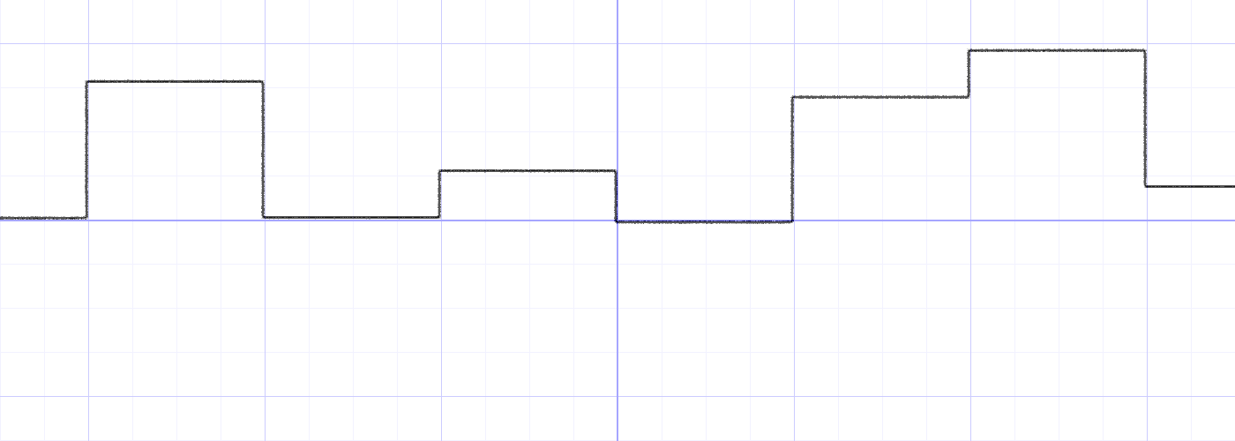
Funções aleatórias
Vamos verificar a função recém criada rand() em GLSL em 1D
vec2 ipos = floor(st); // inteiro
y = rand(ipos);
Referência: The Book of Shaders https://thebookofshaders.com/10/

Slide 10
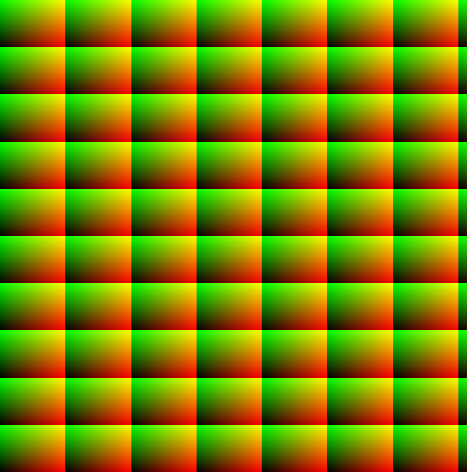
Pergunta
Como ficará a tela agora?
float rand(vec2 st) {
float val = dot(st.xy,vec2(12.9898,78.233));
return fract(sin(val)*43758.5453123);
}
void mainImage(out vec4 fragColor, in vec2 fragCoord){
vec2 st = fragCoord.xy/iResolution.xy;
st *= 10.0;
vec2 fpos = fract(st);
fragColor = vec4(fpos, 0.0 ,1.0);
}
Referência: The Book of Shaders https://thebookofshaders.com/10/
Notes:
Código original:
// Author @patriciogv - 2015
// http://patriciogonzalezvivo.com
#ifdef GL_ES
precision mediump float;
#endif
uniform vec2 u_resolution;
float random(vec2 st) {
float val = dot(st.xy,vec2(12.9898,78.233));
return fract(sin(val)*43758.5453123);
}
void main() {
vec2 st = gl_FragCoord.xy/u_resolution.xy;
float rnd = random(st);
gl_FragColor = vec4(vec3(rnd),1.0);
}

Slide 11
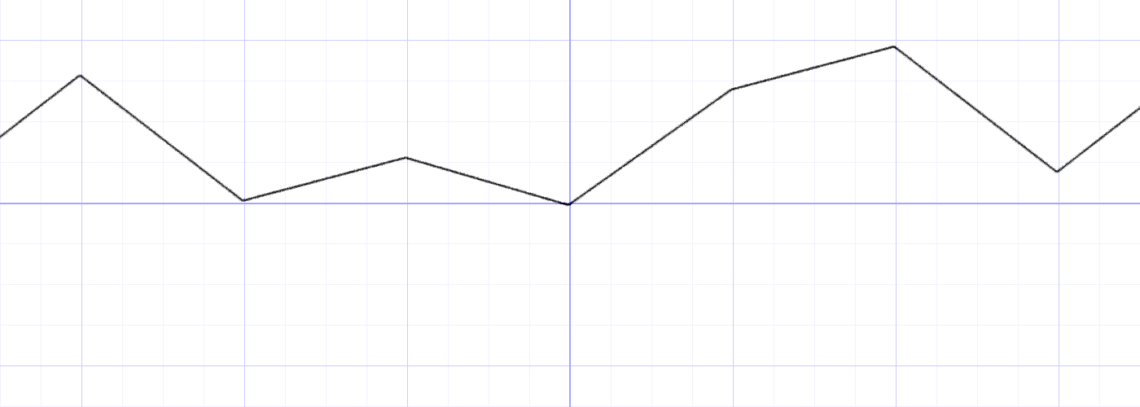
Funções aleatórias
Como você acha que ficaria agora?
vec2 ipos = floor(st); // inteiro
vec2 fpos = fract(st); // fração
y = mix(rand(i), rand(i + 1.0), fpos);
Referência: The Book of Shaders https://thebookofshaders.com/10/

Slide 12
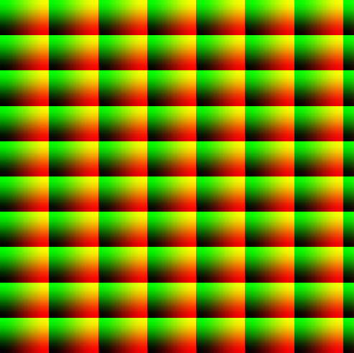
Pergunta
E agora?
float rand(vec2 st) {
float val = dot(st.xy,vec2(12.9898,78.233));
return fract(sin(val)*43758.5453123);
}
void mainImage(out vec4 fragColor, in vec2 fragCoord){
vec2 st = fragCoord.xy/iResolution.xy;
st *= 10.0;
vec2 fpos = fract(st);
fragColor = vec4(smoothstep(0.,1.,fpos), 0.0 ,1.0);
}
Referência: The Book of Shaders https://thebookofshaders.com/10/
Notes:
Código original:
// Author @patriciogv - 2015
// http://patriciogonzalezvivo.com
#ifdef GL_ES
precision mediump float;
#endif
uniform vec2 u_resolution;
float random(vec2 st) {
float val = dot(st.xy,vec2(12.9898,78.233));
return fract(sin(val)*43758.5453123);
}
void main() {
vec2 st = gl_FragCoord.xy/u_resolution.xy;
float rnd = random(st);
gl_FragColor = vec4(vec3(rnd),1.0);
}

Slide 13
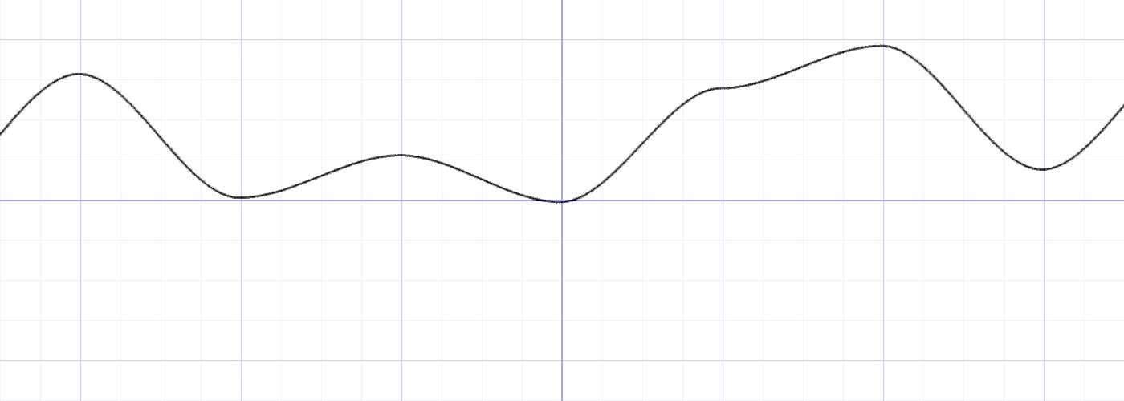
Funções aleatórias
E agora?
vec2 ipos = floor(st); // inteiro
vec2 fpos = fract(st); // fração
y = mix(rand(i), rand(i + 1.0), smoothstep(0.,1.,fpos));
Referência: The Book of Shaders https://thebookofshaders.com/10/

Slide 14
O que é o Perlin Noise
Geração aleatória de valores
Função n-dimensional
Completa aleatoriedade
Coerência

Slide 15
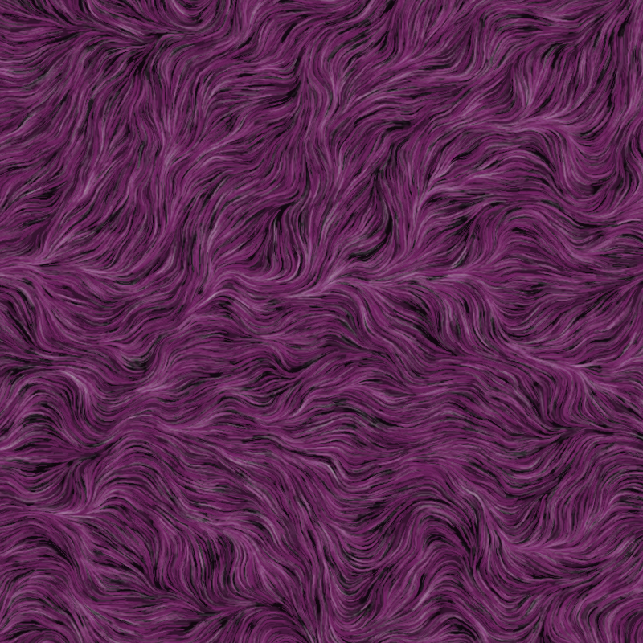
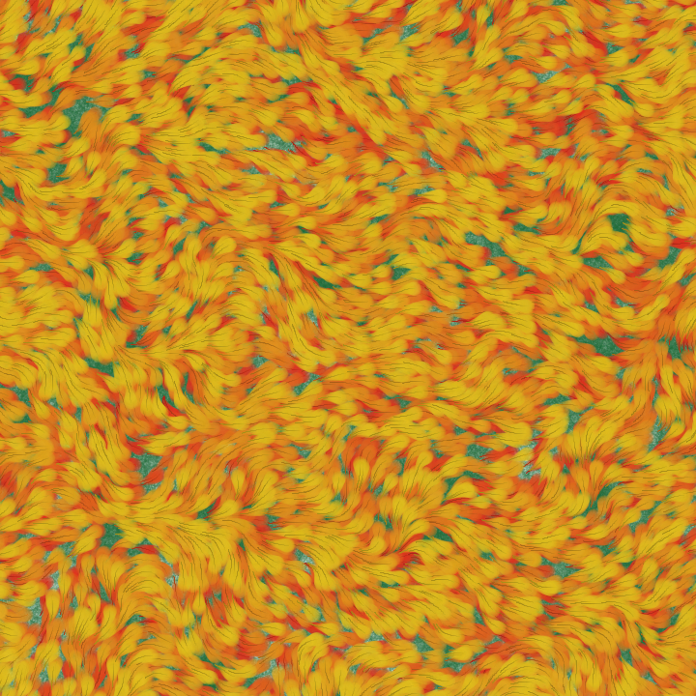
Perlin Noise
Gera padrões mais orgânicos
Percebe-se uma certa suavidade interna
fonte: https://sighack.com/post/getting-creative-with-perlin-noise-fields

Slide 16
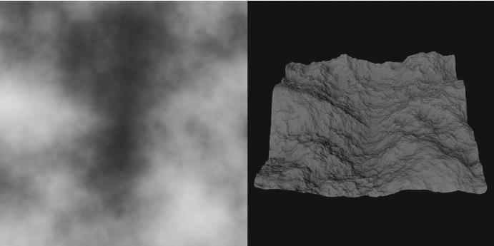
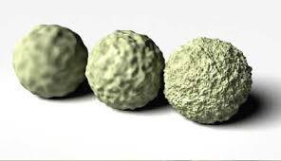
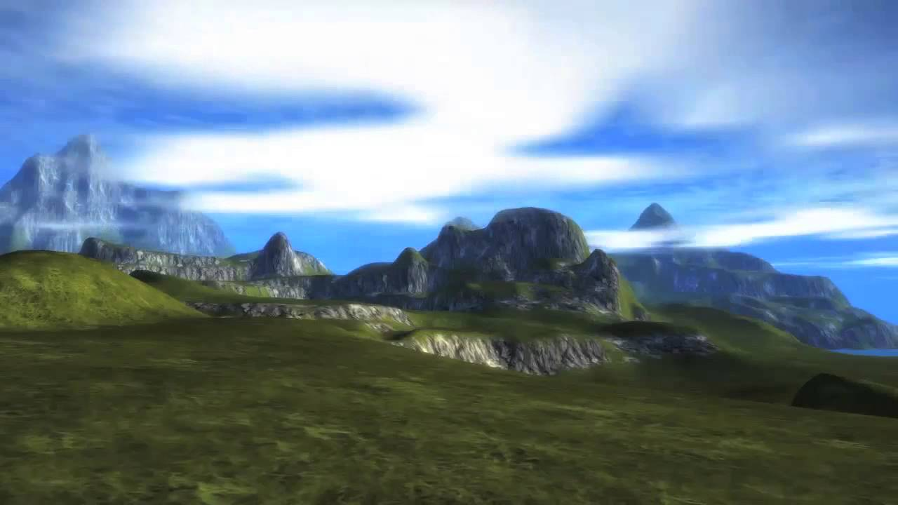
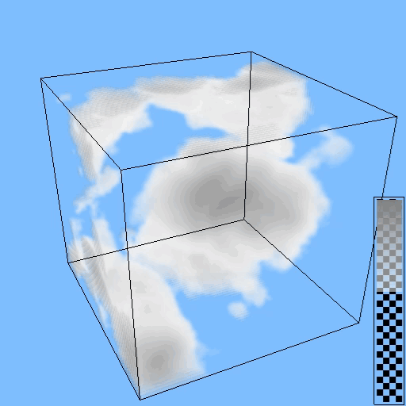
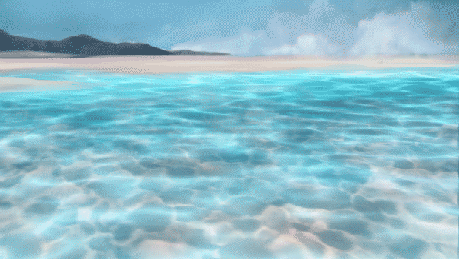
Exemplos usando Perlin Noise
terrenos
rugosidades
FurryBall 4.8
CMSC 425: Lecture 14 Procedural Generation: Perlin Noise
Fig. 2. Seven layers of stacked Perlin noise patterns (left) and the...
nuvens
caustics
https://www.youtube.com/watch?v=n6eaQqKb4y0
https://github.com/BrutPitt/PerlinNoise4D
https://www.tvpaint.com/forum/viewtopic.php?t=11197

Slide 17
Função Parametrizada
função noise(t)
valores
t
amostrando sobre a função.

Slide 18
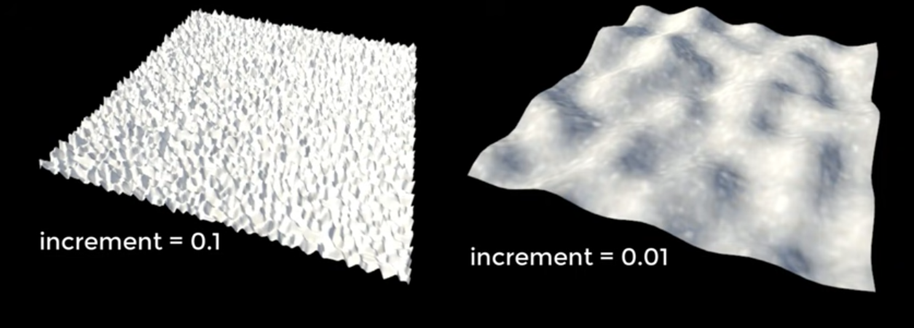
Perlin Noise em 2D
fonte: https://www.youtube.com/watch?v=H6FhG9VKhJg

Slide 19
Explicações da Implementação do Perlin Noise
Passos básicos:
Definição do grid
Produto escalar do gradiente semi-aleatórios e vetores de distância
Interpolação dos produtos escalares

Slide 20
Grid para resultado final
Por exemplo cada célula pode representar um valor de pixel.
um pixel
fonte: http://fataho.com/

Slide 21
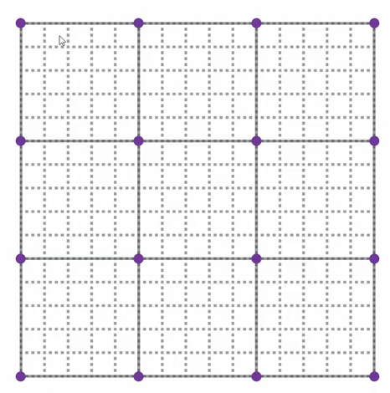
Grid dos valores aleatórios
Uma subdivisão é gerada para identificar os valores aleatórios. No caso os pontos violetas são os valores aleatórios.
Cada um desses vértices tem um valor aleatório.
fonte: http://fataho.com/

Slide 22
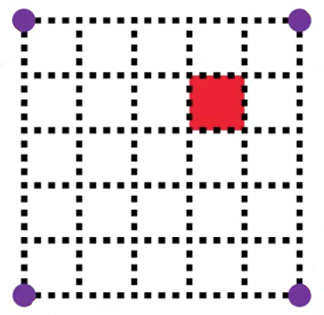
Calculando um valor no grid
fonte: http://fataho.com/

Slide 23
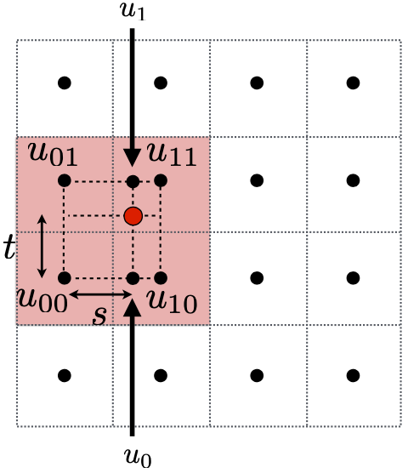
Revisão de Filtro Bilinear
Interpolação Linear (1D)
Interpolações Intermediárias (horizontal)
Interpolação Final (vertical)

Slide 24
Calculando o valor em GLSL
uniform vec2 u_resolution;
float random(vec2 st) {
float val = dot(st.xy,vec2(12.9898,78.233));
return fract(sin(val)*43758.5453123);
}
float noise (in vec2 st) {
vec2 i = floor(st);
vec2 f = fract(st);
// Quatro cantos da célula
float u00 = random(i);
float u10 = random(i + vec2(1.0, 0.0));
float u01 = random(i + vec2(0.0, 1.0));
float u11 = random(i + vec2(1.0, 1.0));
// Interpolação Bilinear
float u0 = mix(u00, u10, f.x);
float u1 = mix(u01, u11, f.x);
return mix(u0, u1, f.y);
}
void main() {
vec2 st = gl_FragCoord.xy/u_resolution.xy;
vec2 pos = vec2(st*3.0);
float n = noise(pos);
gl_FragColor = vec4(vec3(n), 1.0);
}
Referência: The Book of Shaders https://thebookofshaders.com/10/
Notes:
#ifdef GL_ES
precision mediump float;
#endif
uniform vec2 u_resolution;
float random(vec2 st) {
float val = dot(st.xy,vec2(12.9898,78.233));
return fract(sin(val)*43758.5453123);
}
float noise (in vec2 st) {
vec2 i = floor(st);
vec2 f = fract(st);
// Quatro cantos da célula
float u00 = random(i);
float u10 = random(i + vec2(1.0, 0.0));
float u01 = random(i + vec2(0.0, 1.0));
float u11 = random(i + vec2(1.0, 1.0));
// Hermite
vec2 u = smoothstep(0.,1.,f);
// Interpolação Bilinear
float u0 = mix(u00, u10, u.x);
float u1 = mix(u01, u11, u.x);
return mix(u0, u1, u.y);
}
void main() {
vec2 st = gl_FragCoord.xy/u_resolution.xy;
vec2 pos = vec2(st*3.0);
float n = noise(pos);
gl_FragColor = vec4(vec3(n), 1.0);
}

Slide 25
Exemplo em ShaderToy
float random(vec2 st) {
float val = dot(st.xy,vec2(12.9898,78.233));
return fract(sin(val)*43758.5453123);
}
float noise (in vec2 st) {
vec2 i = floor(st);
vec2 f = fract(st);
// Quatro cantos da célula
float u00 = random(i);
float u10 = random(i + vec2(1.0, 0.0));
float u01 = random(i + vec2(0.0, 1.0));
float u11 = random(i + vec2(1.0, 1.0));
// Interpolação Bilinear
float u0 = mix(u00, u10, f.x);
float u1 = mix(u01, u11, f.x);
return mix(u0, u1, f.y);
}
void mainImage( out vec4 fragColor, in vec2 fragCoord ) {
vec2 st = fragCoord.xy/iResolution.xy;
vec2 pos = vec2(st*3.0);
float n = noise(pos);
fragColor = vec4(vec3(n), 1.0);
}

Slide 26
Problemas de Interpolação
Se uma interpolação linear for diretamente utilizada, poderão aparecer artefatos entre os subgrids.
Primeira proposta para solucionar o problema foi:
Que já conhecemos essa interpolação do Hermite, e que no GLSL pode ser usada diretamente com a chamada:
smoothstep()

Slide 27
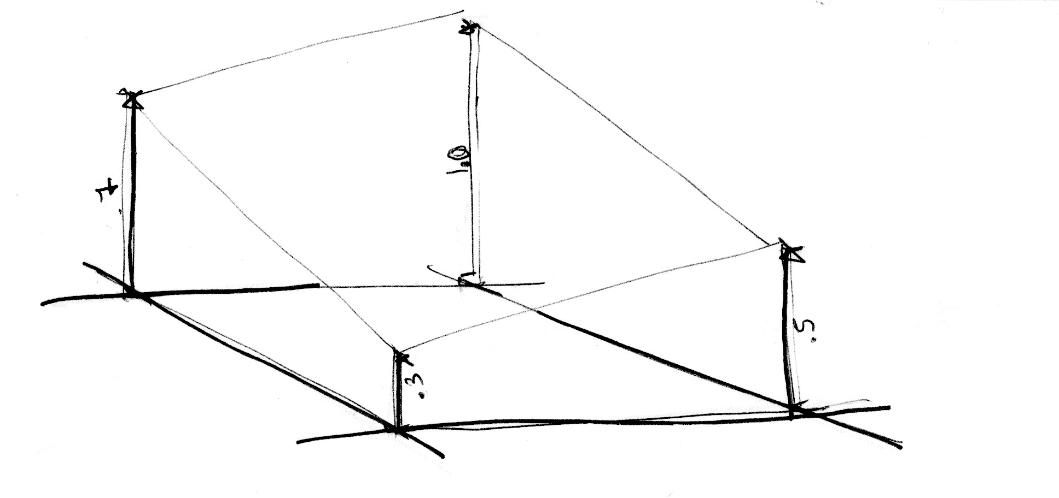
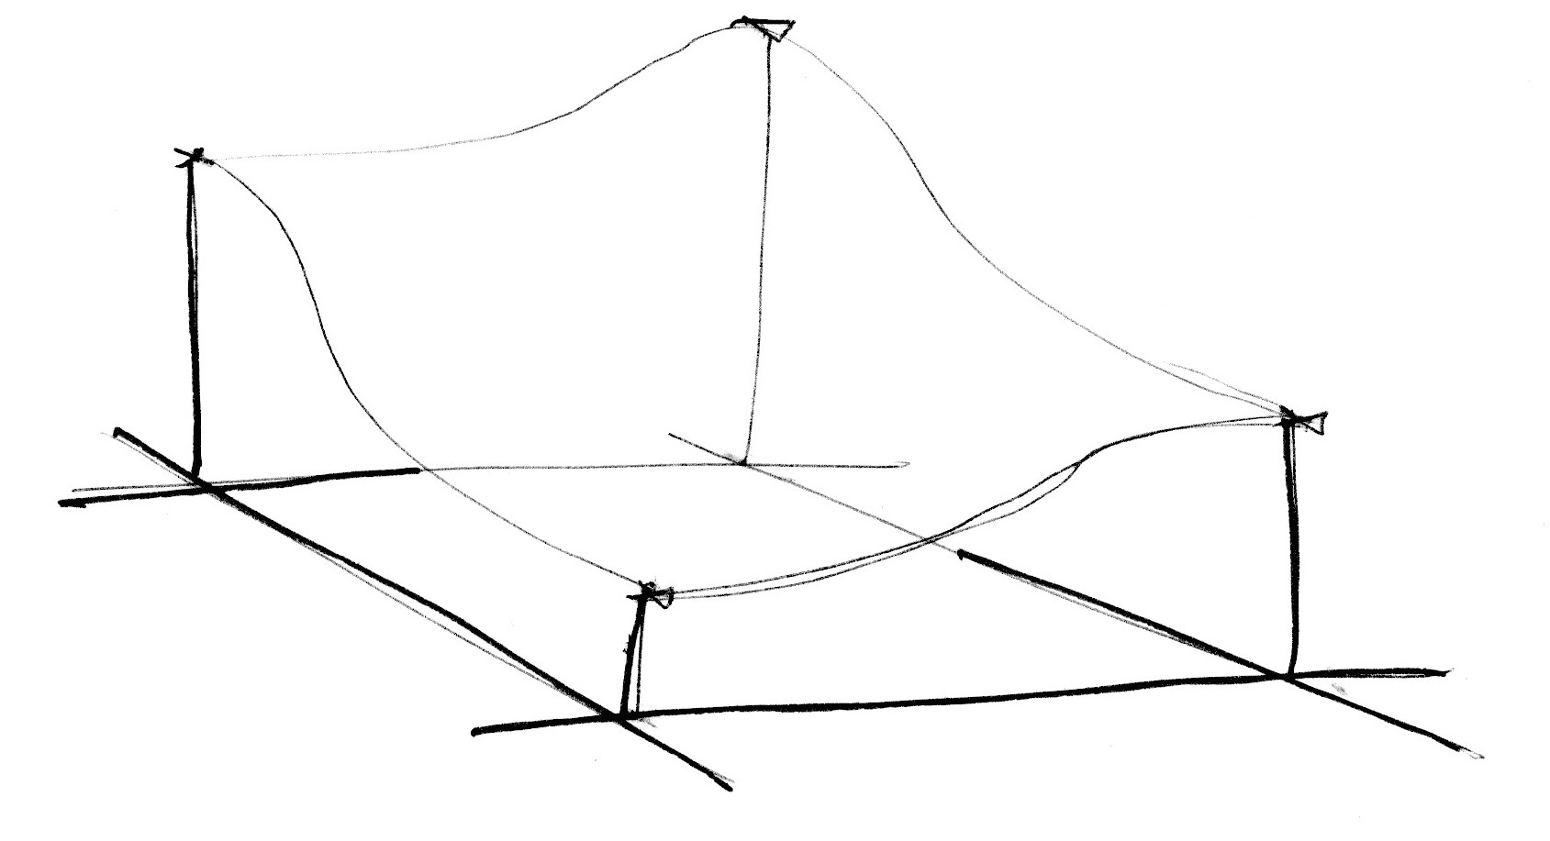
Interpolação Cúbica
Linear
Cúbica (Hermite)
Referência: The Book of Shaders https://thebookofshaders.com/10/
Notes:
#ifdef GL_ES
precision mediump float;
#endif
uniform vec2 u_resolution;
float random(vec2 st) {
float val = dot(st.xy,vec2(12.9898,78.233));
return fract(sin(val)*43758.5453123);
}
float noise (in vec2 st) {
vec2 i = floor(st);
vec2 f = fract(st);
// Quatro cantos da célula
float u00 = random(i);
float u10 = random(i + vec2(1.0, 0.0));
float u01 = random(i + vec2(0.0, 1.0));
float u11 = random(i + vec2(1.0, 1.0));
// Hermite
vec2 u = smoothstep(0.,1.,f);
// Interpolação Bilinear
float u0 = mix(u00, u10, u.x);
float u1 = mix(u01, u11, u.x);
return mix(u0, u1, u.y);
}
void main() {
vec2 st = gl_FragCoord.xy/u_resolution.xy;
vec2 pos = vec2(st*3.0);
float n = noise(pos);
gl_FragColor = vec4(vec3(n), 1.0);
}

Slide 28
Calculando o valor em GLSL
uniform vec2 u_resolution;
float random(vec2 st) {
float val = dot(st.xy,vec2(12.9898,78.233));
return fract(sin(val)*43758.5453123);
}
float noise (in vec2 st) {
vec2 i = floor(st);
vec2 f = fract(st);
// Quatro cantos da célula
float u00 = random(i);
float u10 = random(i + vec2(1.0, 0.0));
float u01 = random(i + vec2(0.0, 1.0));
float u11 = random(i + vec2(1.0, 1.0));
// Hermite
vec2 u = smoothstep(0.,1.,f);
// Interpolação Bilinear
float u0 = mix(u00, u10, u.x);
float u1 = mix(u01, u11, u.x);
return mix(u0, u1, u.y);
}
void main() {
vec2 st = gl_FragCoord.xy/u_resolution.xy;
vec2 pos = vec2(st*3.0);
float n = noise(pos);
gl_FragColor = vec4(vec3(n), 1.0);
}
Referência: The Book of Shaders https://thebookofshaders.com/10/
Notes:
#ifdef GL_ES
precision mediump float;
#endif
uniform vec2 u_resolution;
float random(vec2 st) {
float val = dot(st.xy,vec2(12.9898,78.233));
return fract(sin(val)*43758.5453123);
}
float noise (in vec2 st) {
vec2 i = floor(st);
vec2 f = fract(st);
// Quatro cantos da célula
float u00 = random(i);
float u10 = random(i + vec2(1.0, 0.0));
float u01 = random(i + vec2(0.0, 1.0));
float u11 = random(i + vec2(1.0, 1.0));
// Hermite
vec2 u = smoothstep(0.,1.,f);
// Interpolação Bilinear
float u0 = mix(u00, u10, u.x);
float u1 = mix(u01, u11, u.x);
return mix(u0, u1, u.y);
}
void main() {
vec2 st = gl_FragCoord.xy/u_resolution.xy;
vec2 pos = vec2(st*3.0);
float n = noise(pos);
gl_FragColor = vec4(vec3(n), 1.0);
}

Slide 29
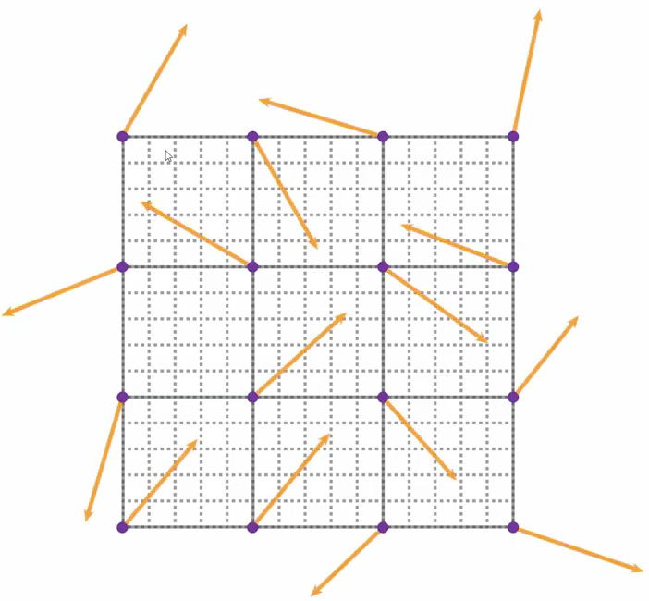
Grid dos vetores aleatórios
Vetores aleatórios são gerados por vértice e depois produtos escalares são realizados.
fonte: http://fataho.com/

Slide 30
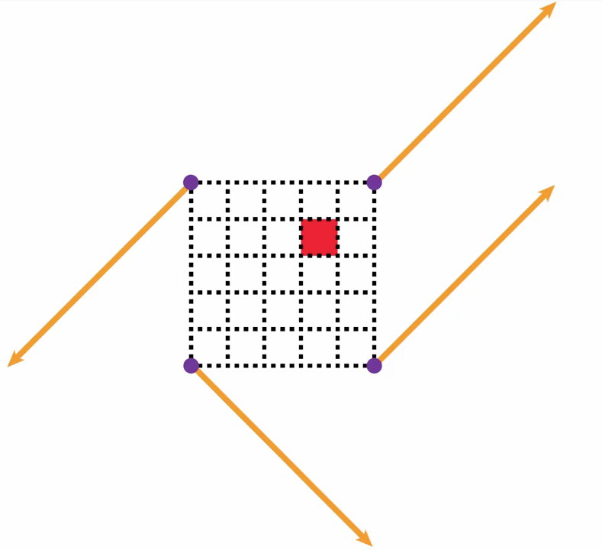
Calculando um valor no grid
fonte: http://fataho.com/

Slide 31
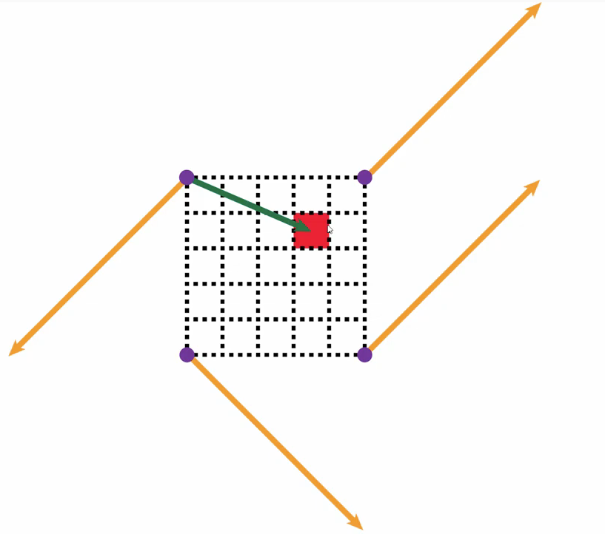
Vetor Distância
fonte: http://fataho.com/

Slide 32
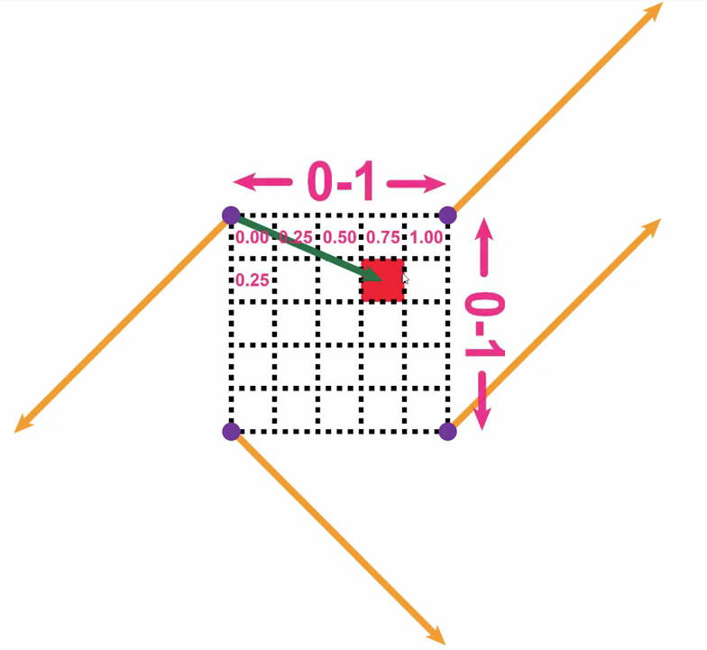
Vetor Distância
fonte: http://fataho.com/

Slide 33
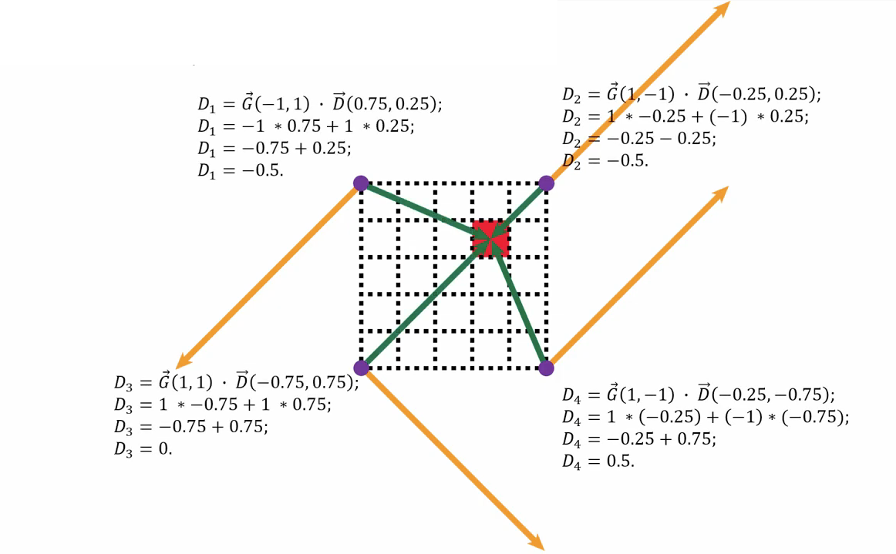
Produtos Escalares dos 4 cantos
fonte: http://fataho.com/

Slide 34
Calculando o valor em GLSL
uniform vec2 u_resolution;
vec2 random2(vec2 st){
vec2 val = vec2(dot(st,vec2(127.1,311.7)),
dot(st,vec2(269.5,183.3)) );
return -1.0 + 2.0*fract(sin(val)*43758.5453123);
}
float noise(vec2 st) {
vec2 i = floor(st); vec2 f = fract(st);
// Quatro cantos da célula
float u00 = dot(random2(i + vec2(0.0,0.0)), f - vec2(0.0,0.0));
float u10 = dot(random2(i + vec2(1.0,0.0)), f - vec2(1.0,0.0));
float u01 = dot(random2(i + vec2(0.0,1.0)), f - vec2(0.0,1.0));
float u11 = dot(random2(i + vec2(1.0,1.0)), f - vec2(1.0,1.0));
// Hermite
vec2 u = smoothstep(0.,1.,f);
// Interpolação Bilinear
float u0 = mix(u00, u10, u.x);
float u1 = mix(u01, u11, u.x);
return mix(u0, u1, u.y)*.5+.5;
}
void main() {
vec2 st = gl_FragCoord.xy/u_resolution.xy;
vec2 pos = vec2(st*3.0);
float n = noise(pos);
gl_FragColor = vec4(vec3(n), 1.0);
}
Referência: The Book of Shaders https://thebookofshaders.com/10/
Notes:
#ifdef GL_ES
precision mediump float;
#endif
uniform vec2 u_resolution;
vec2 random2(vec2 st){
vec2 val = vec2(dot(st,vec2(127.1,311.7)),
dot(st,vec2(269.5,183.3)) );
return -1.0 + 2.0*fract(sin(val)*43758.5453123);
}
float noise(vec2 st) {
vec2 i = floor(st); vec2 f = fract(st);
// Quatro cantos da célula
float u00 = dot(random2(i + vec2(0.0,0.0) ), f - vec2(0.0,0.0));
float u10 = dot(random2(i + vec2(1.0,0.0) ), f - vec2(1.0,0.0));
float u01 = dot(random2(i + vec2(0.0,1.0) ), f - vec2(0.0,1.0));
float u11 = dot(random2(i + vec2(1.0,1.0) ), f - vec2(1.0,1.0));
// Hermite
vec2 u = smoothstep(0.,1.,f);
// Interpolação Bilinear
float u0 = mix(u00, u10, u.x);
float u1 = mix(u01, u11, u.x);
return mix(u0, u1, u.y)*.5+.5;
}
void main() {
vec2 st = gl_FragCoord.xy/u_resolution.xy;
vec2 pos = vec2(st*3.0);
float n = noise(pos);
gl_FragColor = vec4(vec3(n), 1.0);
}

Slide 35
Mais Problemas de Interpolação
A equação do Hermite funcionou bem, porém apresenta descontinuidade na sua segunda derivada, dessa forma a equação usada na versão melhorada (improved) é chamada de Fade Function e tem a seguinte formulação:

Slide 36
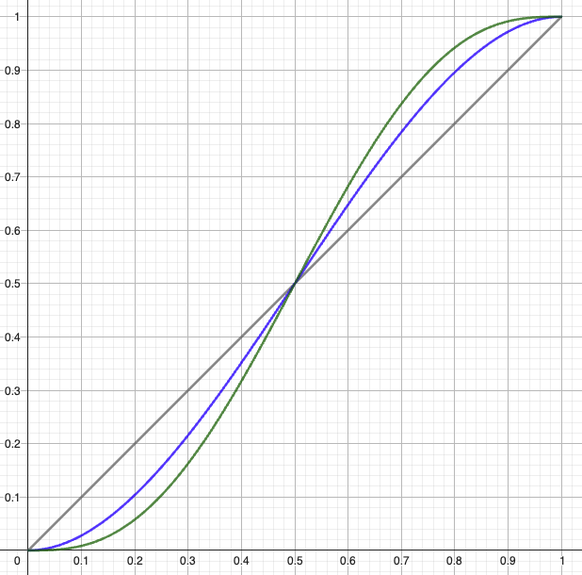
Funções
Linear
l(t) = t
Hermite
h(t) = 3t² - 2t³
Fade
f(t) = 6t⁵ – 15t⁴ + 10t³

Slide 37
Calculando o valor em GLSL
uniform vec2 u_resolution;
vec2 random2(vec2 st){
vec2 val = vec2(dot(st,vec2(127.1,311.7)),
dot(st,vec2(269.5,183.3)) );
return -1.0 + 2.0*fract(sin(val)*43758.5453123);
}
float noise(vec2 st) {
vec2 i = floor(st); vec2 f = fract(st);
// Quatro cantos da célula
float u00 = dot(random2(i + vec2(0.0,0.0)), f - vec2(0.0,0.0));
float u10 = dot(random2(i + vec2(1.0,0.0)), f - vec2(1.0,0.0));
float u01 = dot(random2(i + vec2(0.0,1.0)), f - vec2(0.0,1.0));
float u11 = dot(random2(i + vec2(1.0,1.0)), f - vec2(1.0,1.0));
// Equação quíntica (Fase function)
vec2 u = f*f*f*(f*(f*6.-15.0)+10.0);
// Interpolação Bilinear
float u0 = mix(u00, u10, u.x);
float u1 = mix(u01, u11, u.x);
return mix(u0, u1, u.y)*.5+.5;
}
void main() {
vec2 st = gl_FragCoord.xy/u_resolution.xy;
vec2 pos = vec2(st*3.0);
float n = noise(pos);
gl_FragColor = vec4(vec3(n), 1.0);
}
Hermite
Equação quíntica
Referência: The Book of Shaders https://thebookofshaders.com/10/
Notes:
#ifdef GL_ES
precision mediump float;
#endif
uniform vec2 u_resolution;
vec2 random2(vec2 st){
vec2 val = vec2(dot(st,vec2(127.1,311.7)),
dot(st,vec2(269.5,183.3)) );
return -1.0 + 2.0*fract(sin(val)*43758.5453123);
}
float noise(vec2 st) {
vec2 i = floor(st); vec2 f = fract(st);
// Quatro cantos da célula
float u00 = dot(random2(i + vec2(0.0,0.0) ), f - vec2(0.0,0.0));
float u10 = dot(random2(i + vec2(1.0,0.0) ), f - vec2(1.0,0.0));
float u01 = dot(random2(i + vec2(0.0,1.0) ), f - vec2(0.0,1.0));
float u11 = dot(random2(i + vec2(1.0,1.0) ), f - vec2(1.0,1.0));
// Equação quíntica (Fase function)
vec2 u = f*f*f*(f*(f*6.-15.0)+10.0);
// Interpolação Bilinear
float u0 = mix(u00, u10, u.x);
float u1 = mix(u01, u11, u.x);
return mix(u0, u1, u.y)*.5+.5;
}
void main() {
vec2 st = gl_FragCoord.xy/u_resolution.xy;
vec2 pos = vec2(st*3.0);
float n = noise(pos);
gl_FragColor = vec4(vec3(n), 1.0);
}

Slide 38
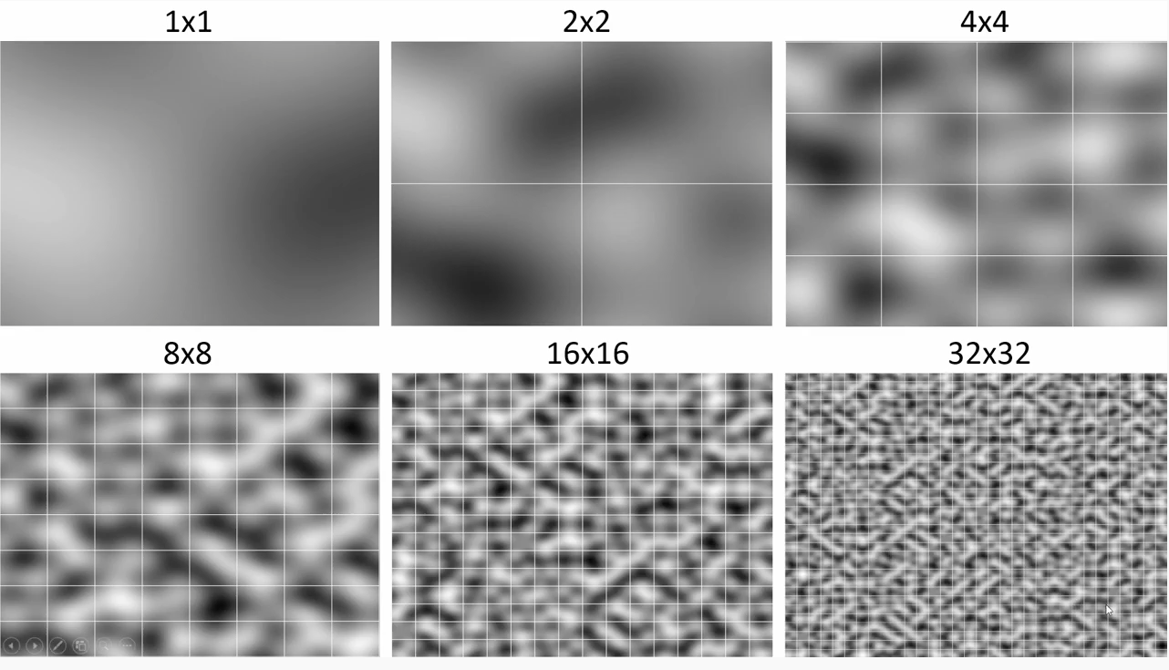
Número de grids
fonte: http://fataho.com/

Slide 39
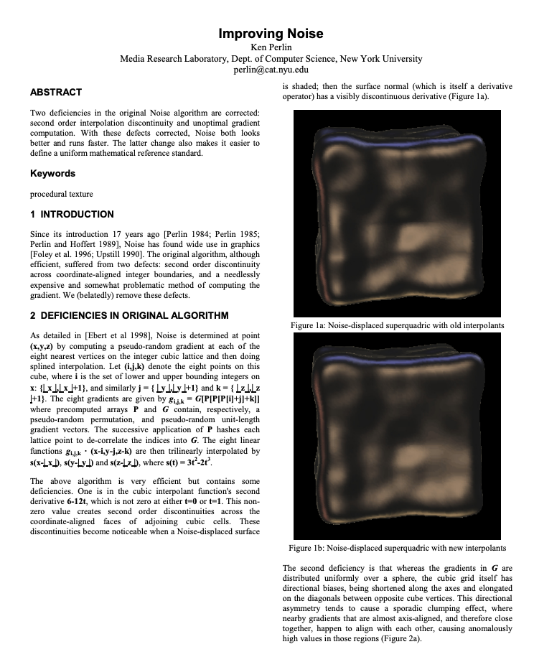
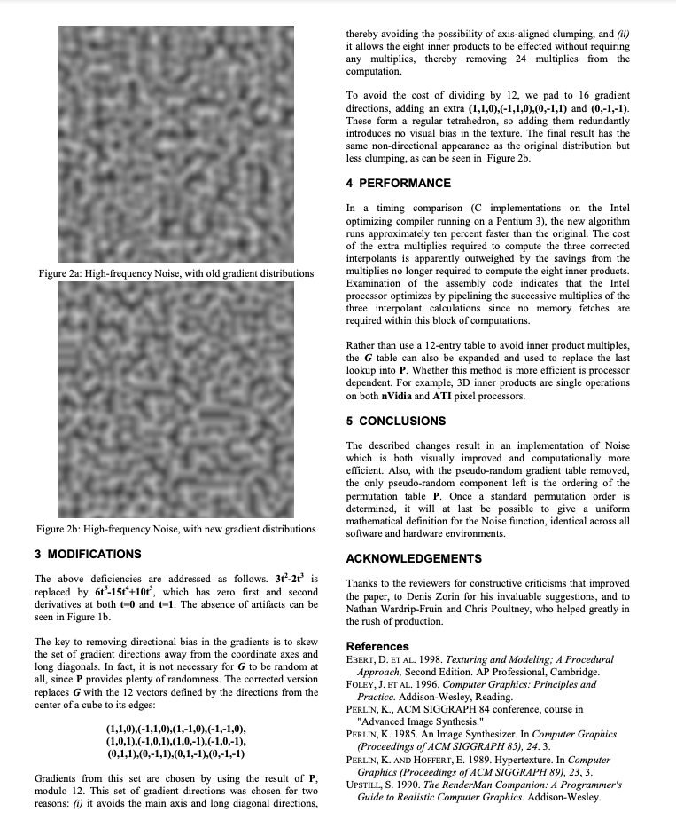
Artigo do Perlin Noise (Improved)
https://mrl.cs.nyu.edu/~perlin/paper445.pdf

Slide 40
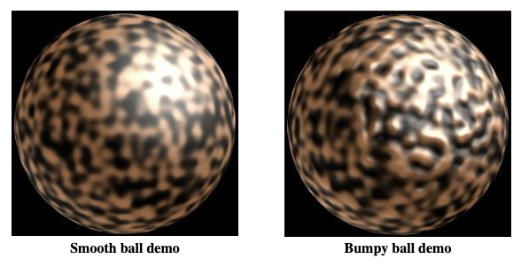
Código do Perlin Noise (Improved)
https://cs.nyu.edu/~perlin/noise/
This code implements the algorithm I describe in a corresponding SIGGRAPH 2002 paper.
// JAVA REFERENCE IMPLEMENTATION OF IMPROVED NOISE - COPYRIGHT 2002 KEN PERLIN.
public final class ImprovedNoise {
static public double noise(double x, double y, double z) {
int X = (int)Math.floor(x) & 255, // FIND UNIT CUBE THAT
Y = (int)Math.floor(y) & 255, // CONTAINS POINT.
Z = (int)Math.floor(z) & 255;
x -= Math.floor(x); // FIND RELATIVE X,Y,Z
y -= Math.floor(y); // OF POINT IN CUBE.
z -= Math.floor(z);
double u = fade(x), // COMPUTE FADE CURVES
v = fade(y), // FOR EACH OF X,Y,Z.
w = fade(z);
int A = p[X ]+Y, AA = p[A]+Z, AB = p[A+1]+Z, // HASH COORDINATES OF
B = p[X+1]+Y, BA = p[B]+Z, BB = p[B+1]+Z; // THE 8 CUBE CORNERS,
return lerp(w, lerp(v, lerp(u, grad(p[AA ], x , y , z ), // AND ADD
grad(p[BA ], x-1, y , z )), // BLENDED
lerp(u, grad(p[AB ], x , y-1, z ), // RESULTS
grad(p[BB ], x-1, y-1, z ))),// FROM 8
lerp(v, lerp(u, grad(p[AA+1], x , y , z-1 ), // CORNERS
grad(p[BA+1], x-1, y , z-1 )), // OF CUBE
lerp(u, grad(p[AB+1], x , y-1, z-1 ),
grad(p[BB+1], x-1, y-1, z-1 ))));
}
static double fade(double t) { return t * t * t * (t * (t * 6 - 15) + 10); }
static double lerp(double t, double a, double b) { return a + t * (b - a); }
static double grad(int hash, double x, double y, double z) {
int h = hash & 15; // CONVERT LO 4 BITS OF HASH CODE
double u = h<8 ? x : y, // INTO 12 GRADIENT DIRECTIONS.
v = h<4 ? y : h==12||h==14 ? x : z;
return ((h&1) == 0 ? u : -u) + ((h&2) == 0 ? v : -v);
}
static final int p[] = new int[512], permutation[] = { 151,160,137,91,90,15,
131,13,201,95,96,53,194,233,7,225,140,36,103,30,69,142,8,99,37,240,21,10,23,
190, 6,148,247,120,234,75,0,26,197,62,94,252,219,203,117,35,11,32,57,177,33,
88,237,149,56,87,174,20,125,136,171,168, 68,175,74,165,71,134,139,48,27,166,
77,146,158,231,83,111,229,122,60,211,133,230,220,105,92,41,55,46,245,40,244,
102,143,54, 65,25,63,161, 1,216,80,73,209,76,132,187,208, 89,18,169,200,196,
135,130,116,188,159,86,164,100,109,198,173,186, 3,64,52,217,226,250,124,123,
5,202,38,147,118,126,255,82,85,212,207,206,59,227,47,16,58,17,182,189,28,42,
223,183,170,213,119,248,152, 2,44,154,163, 70,221,153,101,155,167, 43,172,9,
129,22,39,253, 19,98,108,110,79,113,224,232,178,185, 112,104,218,246,97,228,
251,34,242,193,238,210,144,12,191,179,162,241, 81,51,145,235,249,14,239,107,
49,192,214, 31,181,199,106,157,184, 84,204,176,115,121,50,45,127, 4,150,254,
138,236,205,93,222,114,67,29,24,72,243,141,128,195,78,66,215,61,156,180
};
static { for (int i=0; i < 256 ; i++) p[256+i] = p[i] = permutation[i]; }
}

Slide 41
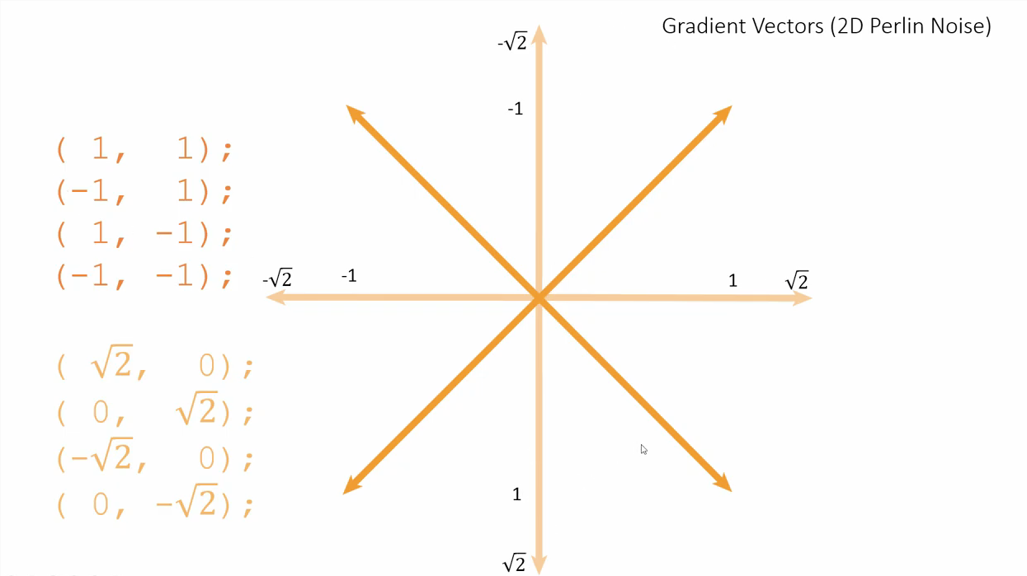
Vetores Gradiente 2D
fonte: http://fataho.com/

Slide 42
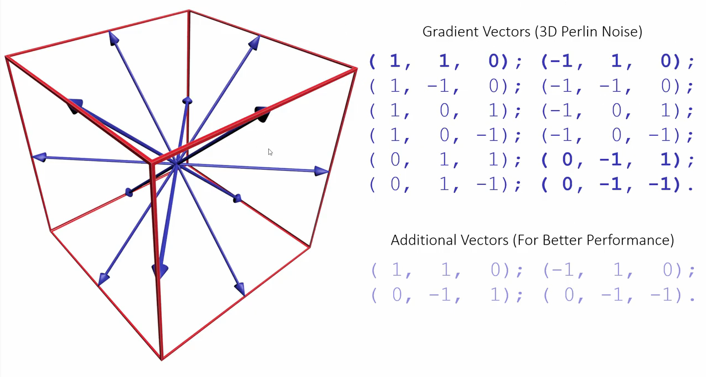
Vetores Gradiente 3D
fonte: http://fataho.com/

Slide 43
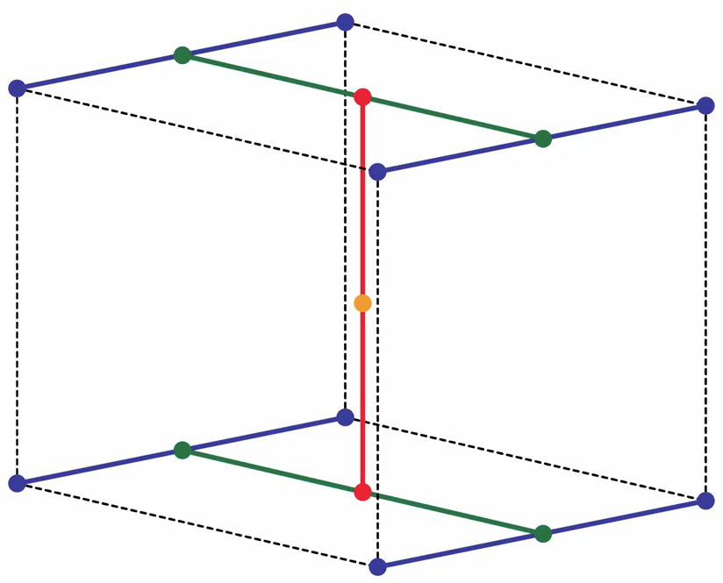
Interpolação Trilinear
fonte: http://fataho.com/

Slide 44
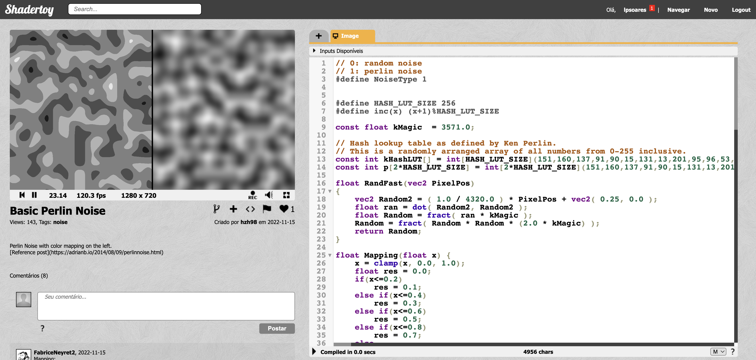
Exemplo no Shadertoy
https://www.shadertoy.com/view/NlKBzm
Notes:
// 0: random noise
// 1: perlin noise
#define NoiseType 1
#define HASH_LUT_SIZE 256
#define inc(x) (x+1)%HASH_LUT_SIZE
const float kMagic = 3571.0;
// Hash lookup table as defined by Ken Perlin.
// This is a randomly arranged array of all numbers from 0-255 inclusive.
const int kHashLUT[] = int[HASH_LUT_SIZE](151,160,137,91,90,15,131,13,201,95,96,53,194,233,7,225,140,36,103,30,69,142,8,99,37,240,21,10,23,190, 6,148,247,120,234,75,0,26,197,62,94,252,219,203,117,35,11,32,57,177,33,88,237,149,56,87,174,20,125,136,171,168, 68,175,74,165,71,134,139,48,27,166,77,146,158,231,83,111,229,122,60,211,133,230,220,105,92,41,55,46,245,40,244,102,143,54, 65,25,63,161, 1,216,80,73,209,76,132,187,208, 89,18,169,200,196,135,130,116,188,159,86,164,100,109,198,173,186, 3,64,52,217,226,250,124,123,5,202,38,147,118,126,255,82,85,212,207,206,59,227,47,16,58,17,182,189,28,42,223,183,170,213,119,248,152, 2,44,154,163, 70,221,153,101,155,167, 43,172,9,129,22,39,253, 19,98,108,110,79,113,224,232,178,185, 112,104,218,246,97,228,251,34,242,193,238,210,144,12,191,179,162,241, 81,51,145,235,249,14,239,107,49,192,214, 31,181,199,106,157,184, 84,204,176,115,121,50,45,127, 4,150,254,138,236,205,93,222,114,67,29,24,72,243,141,128,195,78,66,215,61,156,180);
const int p[2*HASH_LUT_SIZE] = int[2*HASH_LUT_SIZE](151,160,137,91,90,15,131,13,201,95,96,53,194,233,7,225,140,36,103,30,69,142,8,99,37,240,21,10,23,190, 6,148,247,120,234,75,0,26,197,62,94,252,219,203,117,35,11,32,57,177,33,88,237,149,56,87,174,20,125,136,171,168, 68,175,74,165,71,134,139,48,27,166,77,146,158,231,83,111,229,122,60,211,133,230,220,105,92,41,55,46,245,40,244,102,143,54, 65,25,63,161, 1,216,80,73,209,76,132,187,208, 89,18,169,200,196,135,130,116,188,159,86,164,100,109,198,173,186, 3,64,52,217,226,250,124,123,5,202,38,147,118,126,255,82,85,212,207,206,59,227,47,16,58,17,182,189,28,42,223,183,170,213,119,248,152, 2,44,154,163, 70,221,153,101,155,167, 43,172,9,129,22,39,253, 19,98,108,110,79,113,224,232,178,185, 112,104,218,246,97,228,251,34,242,193,238,210,144,12,191,179,162,241, 81,51,145,235,249,14,239,107,49,192,214, 31,181,199,106,157,184, 84,204,176,115,121,50,45,127, 4,150,254,138,236,205,93,222,114,67,29,24,72,243,141,128,195,78,66,215,61,156,180,151,160,137,91,90,15,131,13,201,95,96,53,194,233,7,225,140,36,103,30,69,142,8,99,37,240,21,10,23,190, 6,148,247,120,234,75,0,26,197,62,94,252,219,203,117,35,11,32,57,177,33,88,237,149,56,87,174,20,125,136,171,168, 68,175,74,165,71,134,139,48,27,166,77,146,158,231,83,111,229,122,60,211,133,230,220,105,92,41,55,46,245,40,244,102,143,54, 65,25,63,161, 1,216,80,73,209,76,132,187,208, 89,18,169,200,196,135,130,116,188,159,86,164,100,109,198,173,186, 3,64,52,217,226,250,124,123,5,202,38,147,118,126,255,82,85,212,207,206,59,227,47,16,58,17,182,189,28,42,223,183,170,213,119,248,152, 2,44,154,163, 70,221,153,101,155,167, 43,172,9,129,22,39,253, 19,98,108,110,79,113,224,232,178,185, 112,104,218,246,97,228,251,34,242,193,238,210,144,12,191,179,162,241, 81,51,145,235,249,14,239,107,49,192,214, 31,181,199,106,157,184, 84,204,176,115,121,50,45,127, 4,150,254,138,236,205,93,222,114,67,29,24,72,243,141,128,195,78,66,215,61,156,180);
float RandFast(vec2 PixelPos)
{
vec2 Random2 = ( 1.0 / 4320.0 ) * PixelPos + vec2( 0.25, 0.0 );
float ran = dot( Random2, Random2 );
float Random = fract( ran * kMagic );
Random = fract( Random * Random * (2.0 * kMagic) );
return Random;
}
float Mapping(float x) {
x = clamp(x, 0.0, 1.0);
float res = 0.0;
if(x<=0.2)
res = 0.1;
else if(x<=0.4)
res = 0.3;
else if(x<=0.6)
res = 0.5;
else if(x<=0.8)
res = 0.7;
else
res = 0.9;
return res;
}
float FadeSmooth(float x) {
float t = clamp(x, 0.0, 1.0);
float t_2 = t * t;
float res = t_2 * t * (6.0*t_2 - 15.0*t + 10.0);
return res;
}
vec2 RandomVector2D() {
return vec2(0.0, 0.0);
}
// pick a random vector
float Grad(int hash, float x, float y, float z) {
int h = hash & 15;
float u = h < 8 /* 0b1000 */ ? x : y;
float v;
if(h < 4 /* 0b0100 */)
v = y;
else if(h == 12 /* 0b1100 */ || h == 14 /* 0b1110*/)
v = x;
else
v = z;
return ((h&1) == 0 ? u : -u)+((h&2) == 0 ? v : -v);
}
float PerliNoise3D(float x, float y, float z) {
float repeat = 0.0;
if(repeat > 0.0) {
x = mod(x, repeat);
y = mod(y, repeat);
z = mod(z, repeat);
}
int xi = int(x) & 255;
int yi = int(y) & 255;
int zi = int(z) & 255;
float xf = fract(x);
float yf = fract(y);
float zf = fract(z);
float u = FadeSmooth(xf);
float v = FadeSmooth(yf);
float w = FadeSmooth(zf);
int aaa, aba, aab, abb, baa, bba, bab, bbb;
aaa = p[p[p[ xi ]+ yi ]+ zi ];
aba = p[p[p[ xi ]+inc(yi)]+ zi ];
aab = p[p[p[ xi ]+ yi ]+inc(zi)];
abb = p[p[p[ xi ]+inc(yi)]+inc(zi)];
baa = p[p[p[inc(xi)]+ yi ]+ zi ];
bba = p[p[p[inc(xi)]+inc(yi)]+ zi ];
bab = p[p[p[inc(xi)]+ yi ]+inc(zi)];
bbb = p[p[p[inc(xi)]+inc(yi)]+inc(zi)];
float x1, x2, y1, y2;
x1 = mix(Grad(aaa, xf, yf, zf), Grad(baa, xf-1.0, yf, zf), u);
x2 = mix(Grad(aba, xf, yf-1.0, zf), Grad(bba, xf-1.0, yf-1.0, zf), u);
y1 = mix(x1, x2, v);
x1 = mix(Grad(aab, xf, yf, zf-1.0), Grad(bab, xf-1.0, yf, zf-1.0), u);
x2 = mix(Grad(abb, xf, yf-1.0, zf-1.0), Grad(bbb, xf-1.0, yf-1.0, zf-1.0), u);
y2 = mix (x1, x2, v);
return (mix(y1, y2, w)+1.0)/2.0;
}
void mainImage( out vec4 fragColor, in vec2 fragCoord )
{
vec2 uv = fragCoord / iResolution.y; // keep the original aspect ratio
// vec2 uv = fragCoord / iResolution.xy; // normalize uv to [0,1] but distort the original image
vec2 noise_uv = uv + vec2(iTime) * 0.1;
float res = PerliNoise3D(10.0*noise_uv.x, 10.0*noise_uv.y, 0.0);
if(NoiseType==0) {
res = RandFast(fragCoord);
}
else if(NoiseType==1) {
if(uv.x * iResolution.y < (0.5-0.002)*iResolution.x) {
res = Mapping(res);
}
else if(uv.x * iResolution.y > (0.5+0.002)*iResolution.x) {
// do nothing
;
}
else{
res = 0.0;
}
}
else {
// seperator
res = 0.0;
}
fragColor = vec4(vec3(res), 1.0);
}

Slide 45
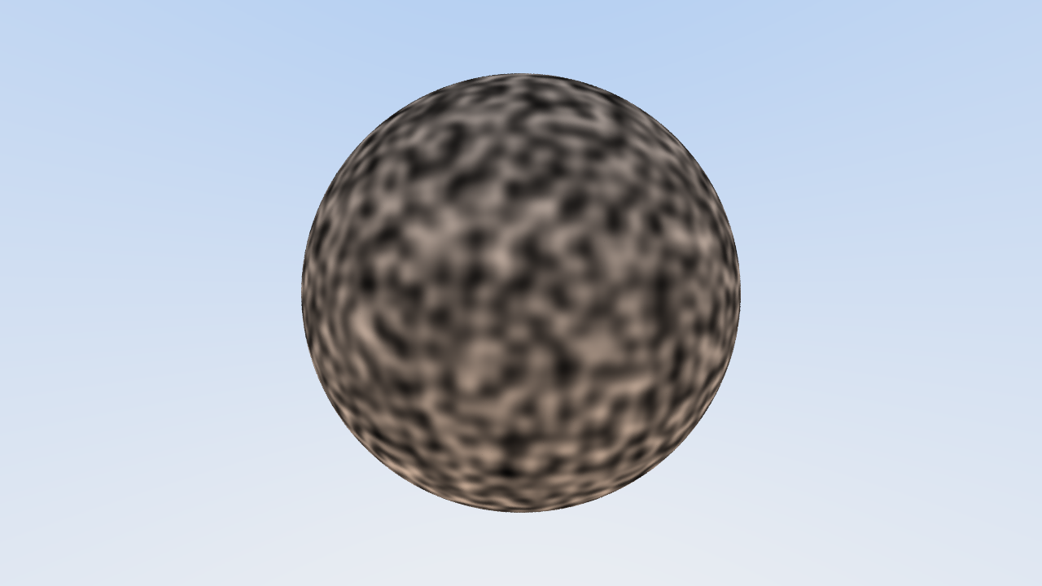
Teste no Ray Tracer
Notes:
https://www.shadertoy.com/view/DlKGDd

Slide 46
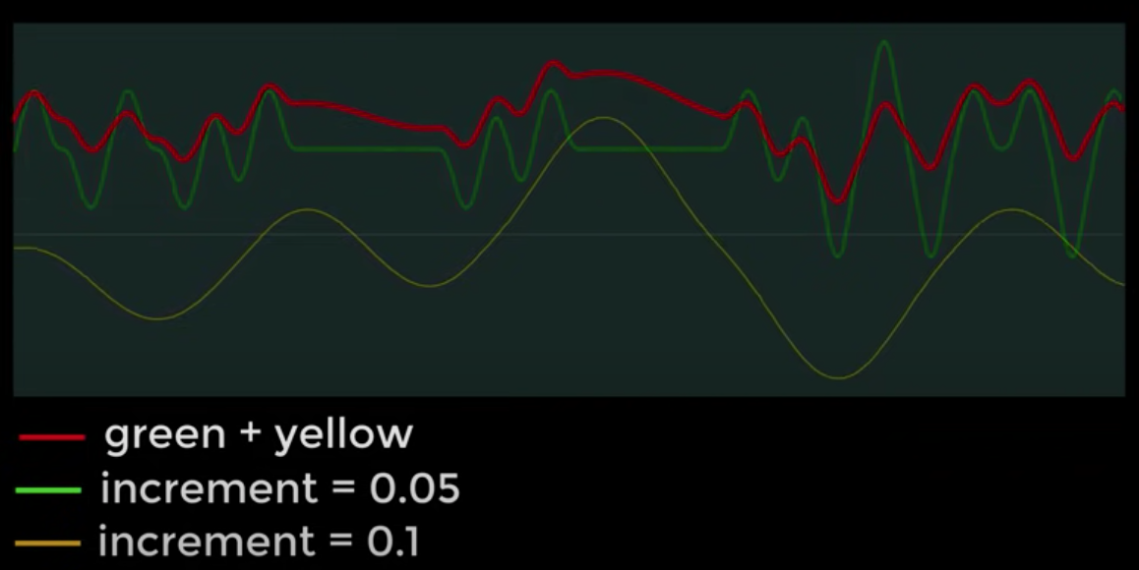
Combinando padrões (Turbulência)
fonte: https://www.youtube.com/watch?v=H6FhG9VKhJg

Slide 47
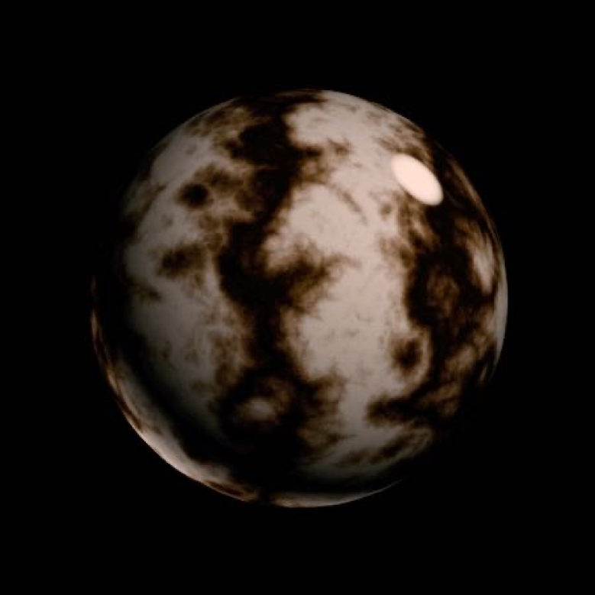
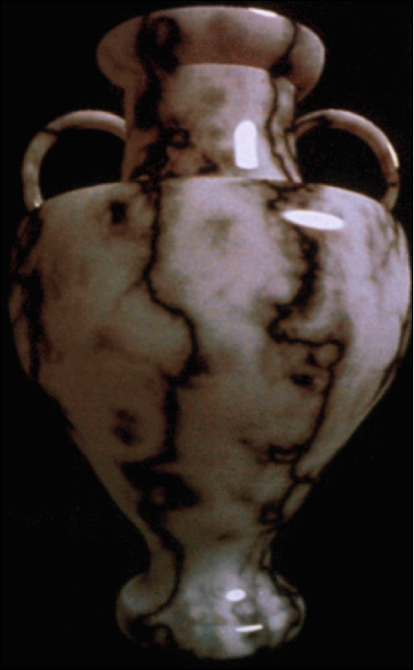
Ruído Procedural em 3D + Modelagem de Sólidos
Perlin noise, Ken Perlin

Slide 48
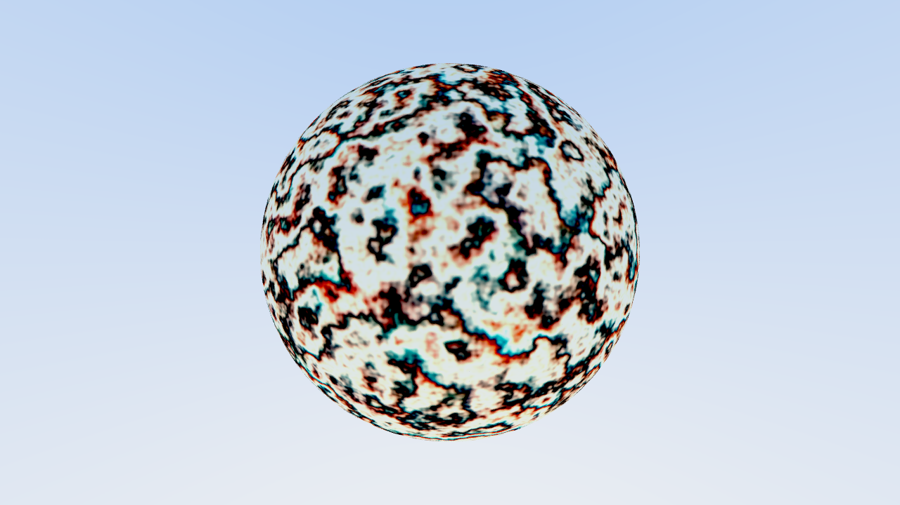
Teste de Turbulência no Ray Tracer
Notes:
https://www.shadertoy.com/view/DlKGDd

Slide 49
Próxima parte do projeto
A próxima parte do projeto tem um viés artístico.
Você deverá criar uma textura 2D/3D, baseado em algum algoritmo do Perlin Noise.

Slide 50
Live coding ruido em blocos
https://www.shadertoy.com/view/4XXfW8

Slide 51
Computação Gráfica
Luciano Soares
<lpsoares@insper.edu.br>
Fabio Orfali
<fabioO1@insper.edu.br>

